Slide 1
Convolutional LSTM for image processing
Armando Vieira
http://armando.lidinwise.com @lidinwise
armandosairmais@gmail.com

Slide 2
Summary
what is a recurrent network and why it matters
What is a LSTM and a CNN
The convolutional LSTM
How to implement it in Keras & Tensorflow
Supervised and unsupervised mode
Applications: Weather forecasting, Self-driving cars, Image segmentation

Slide 3
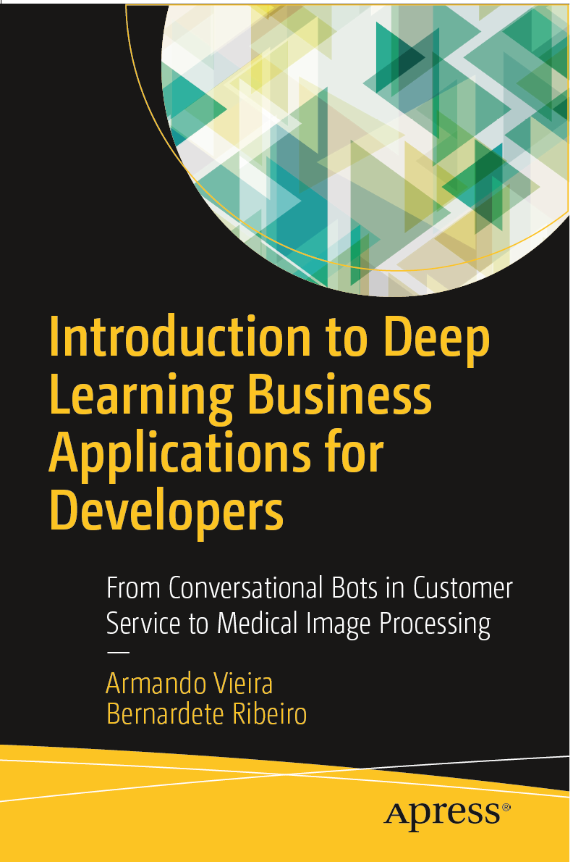
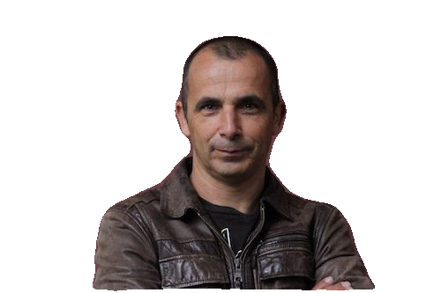
Data Scientist, Consultant, Deep Learning pioneer
Author of the Book Business Applications of Deep Learning
May 2018, Apress, New York

Slide 4
Why recursivity matters and why it’s hard to deal?
f(x) = 3.5 x (1 − x)
f(f(f(f(x)))) = ?

Slide 5
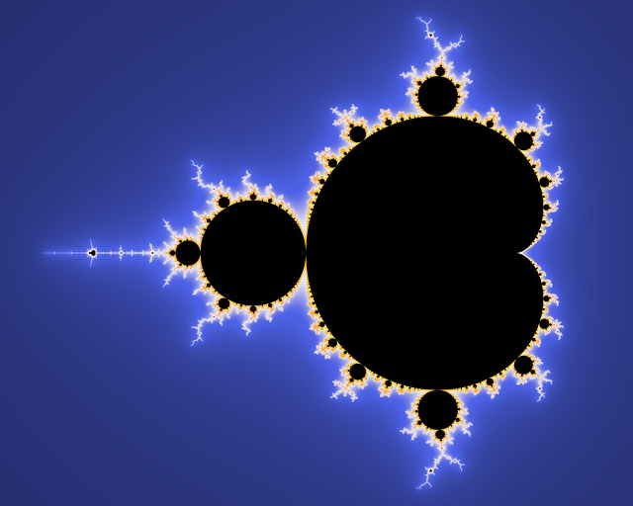

Slide 6
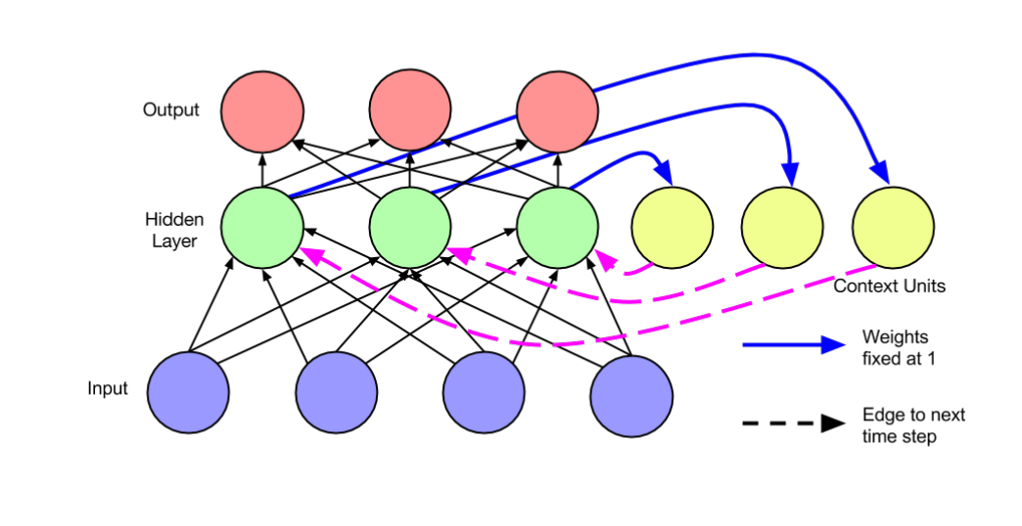
What is a Recurrent Network?

Slide 7
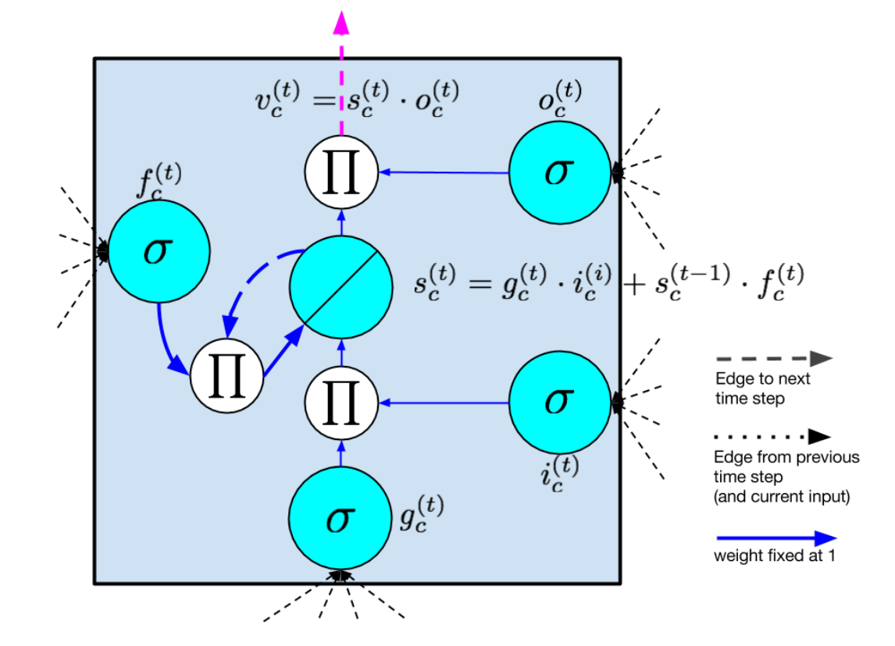
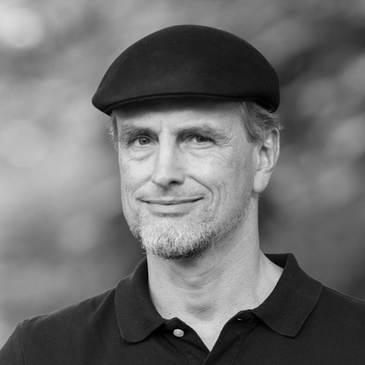
Schmidhuber 1997
LSTM

Slide 8
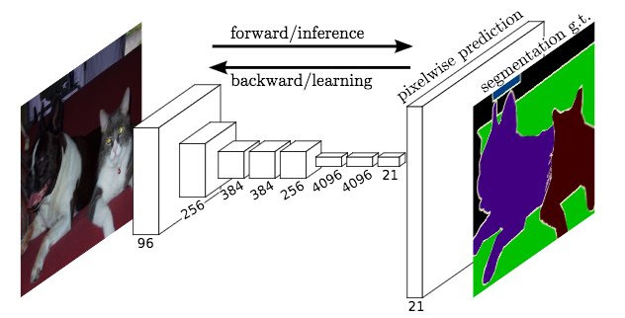
FCNNs

Slide 9
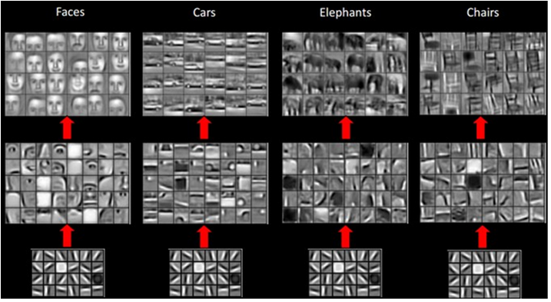

Slide 10
Convolutional LSTM + FCN
Main idea: FCN Conv. Layers are replaced with ConvLSTM layers
ConvLSTM is similar to fully connected LSTM

Slide 11
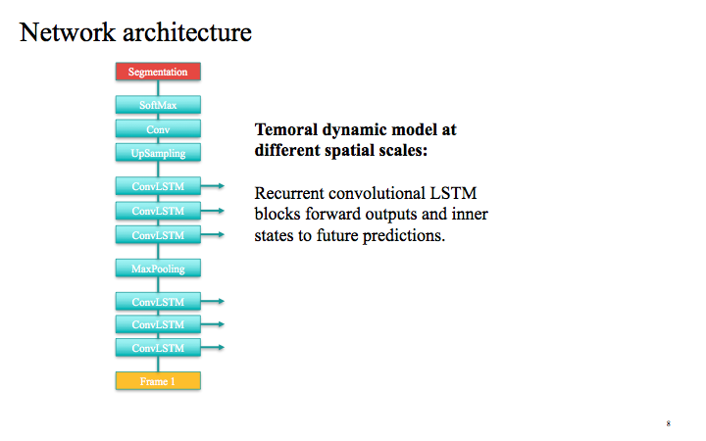

Slide 12
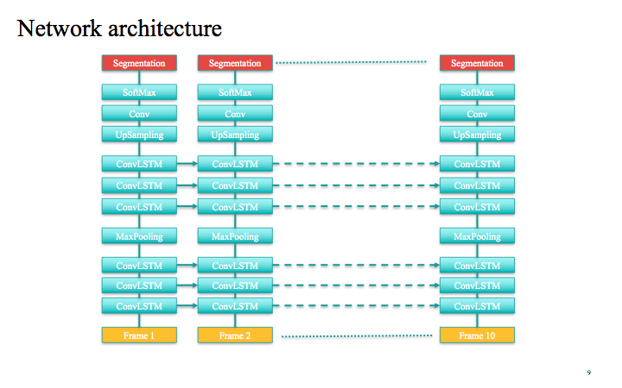

Slide 13
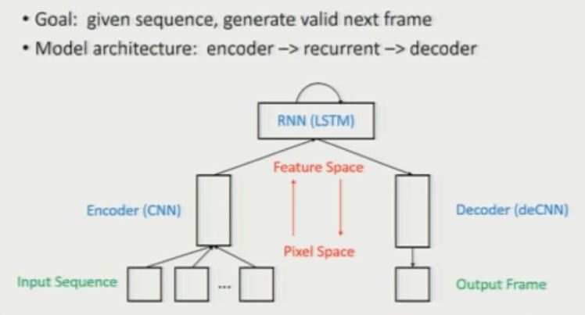
Unsupervised: learning representation of the world

Slide 14
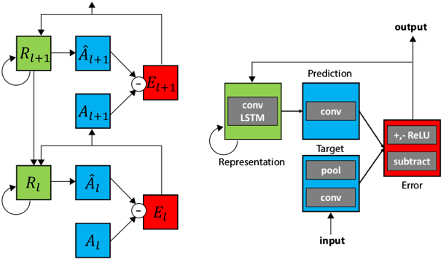
Two models
Non supervised (next frame prediction)
Supervised (sequence to sequence)

Slide 15
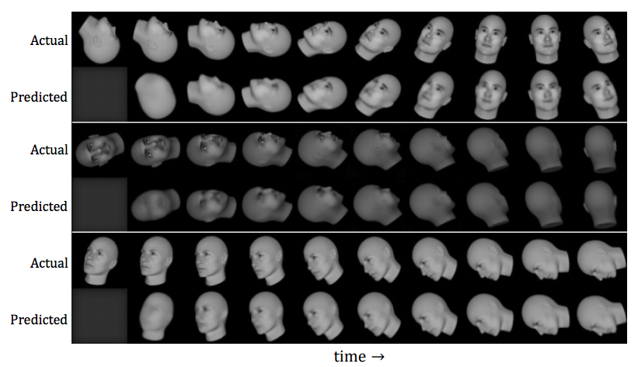

Slide 16
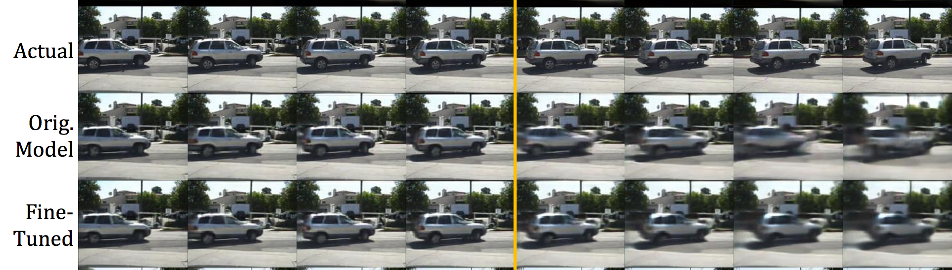
Self driving cars: Kitti dataset
https://coxlab.github.io/prednet/
https://coxlab.github.io/prednet/prednet_animation.html

Slide 17
Bouncing balls:
learning physics from scratch
https://www.youtube.com/watch?v=RjZ1VKYyHhs

Slide 18
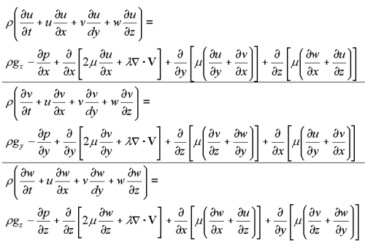
Weather forecasting

Slide 19
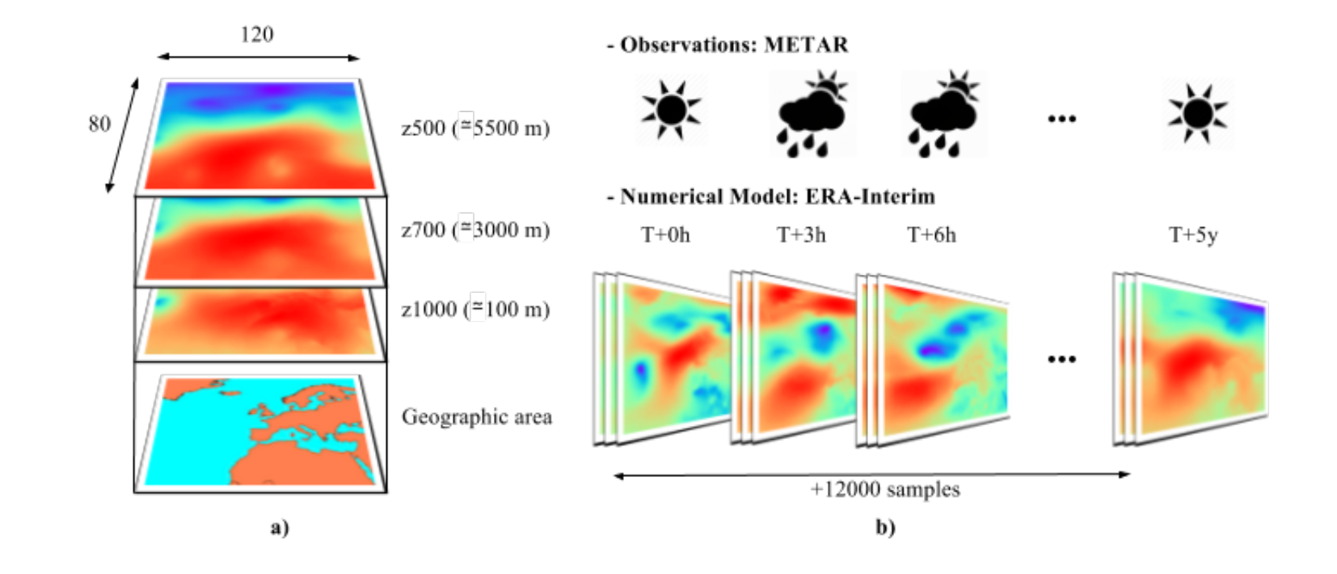
As a convolutional LSTM
weather

Slide 20
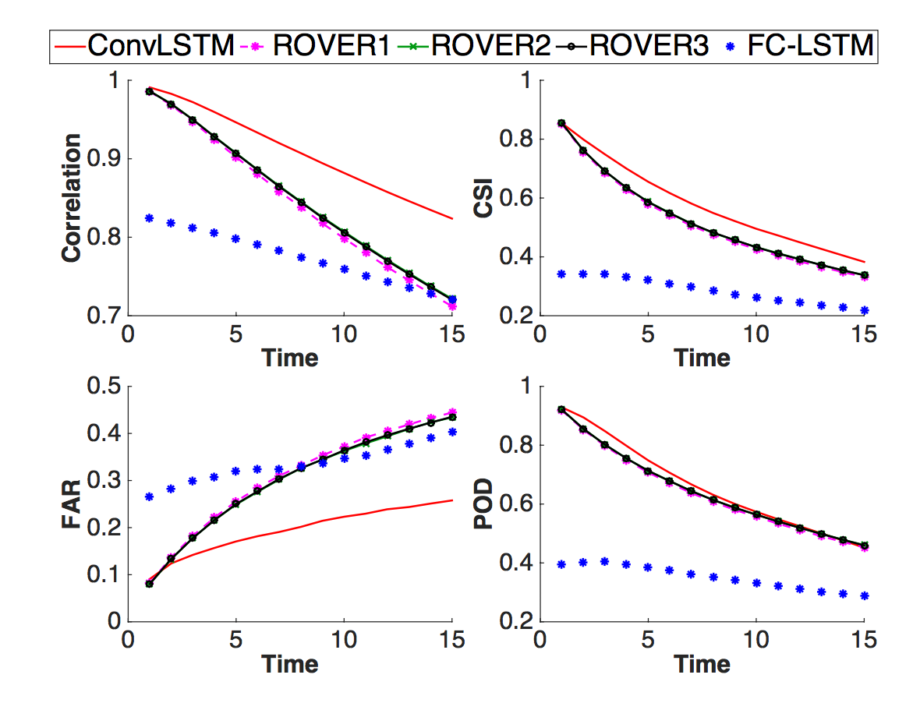
Xingjian Shi et al., 2015

Slide 21
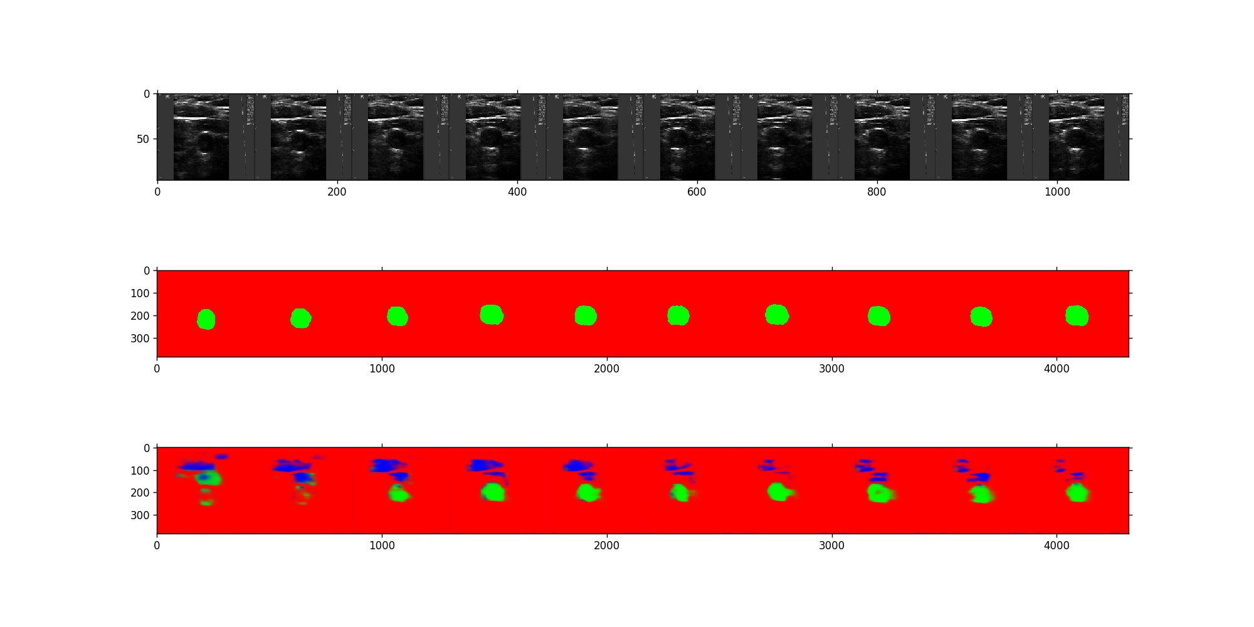
Image segmentation

Slide 22
Resources
Convolutional LSTM in Tensorflow
Convolutional LSTM Network: A Machine Learning Approach for Precipitation Nowcasting
Prednet (Keras Layer) see video
Bouncing balls example
Review recurrent networks
CGRU https://arxiv.org/pdf/1511.08228.pdf (paper) https://github.com/openai/neural-gpu/tree/master/neuralgpu (code) https://github.com/chiphuyen/stanford-tensorflow-tutorials/tree/master/examples/cgru (code II) and an example https://ctmakro.github.io/site/on_learning/gru/gru.html

Slide 23
Conclusions
Suited to spatio temporal patterns (videos, wheather)
Anomaly detection
Learn model of the world
Computationally intensive
Tensorflow implementation through CGRUs

Slide 24
My new book
Applications of Deep Learning, APRESS (to be released Jan 2018)

